Slide 1
BTT Recorder v1.4
Recording from project management
Audio Recordings
Without source audio

Slide 2
Audio Recordings
Audio recordings are recordings that are done by someone that can read a source text.
Audio recordings can be created for:
A Gateway Language source audio.
When a translator translates from a written text that they can read into their Heart Language that is not a written language.
When a language group would like to have an audio recording of their written Bible to be used by those that cannot read the language.

Slide 3
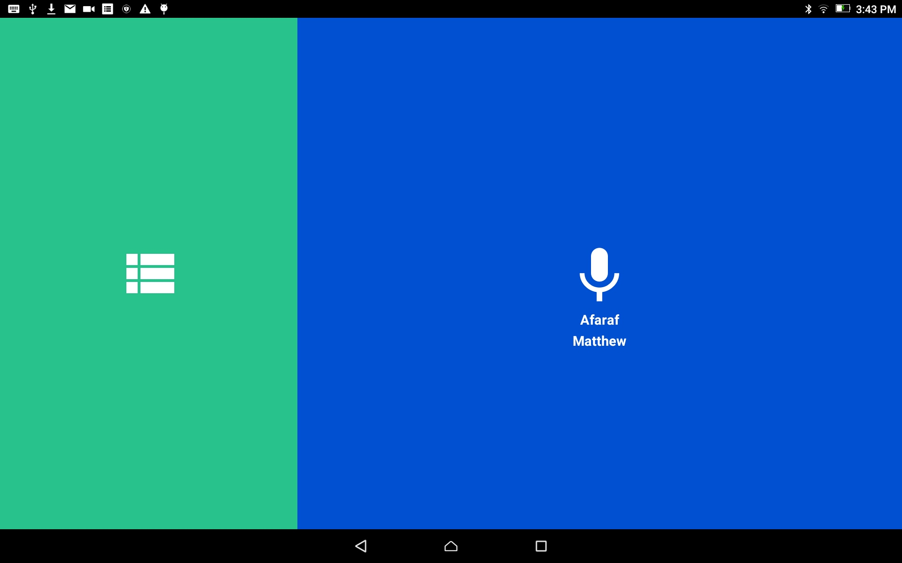
Audio Recordings
From the home screen, tap in the green area to open the Project Management screen.
This step is for when the user returns to a recording session

Slide 4
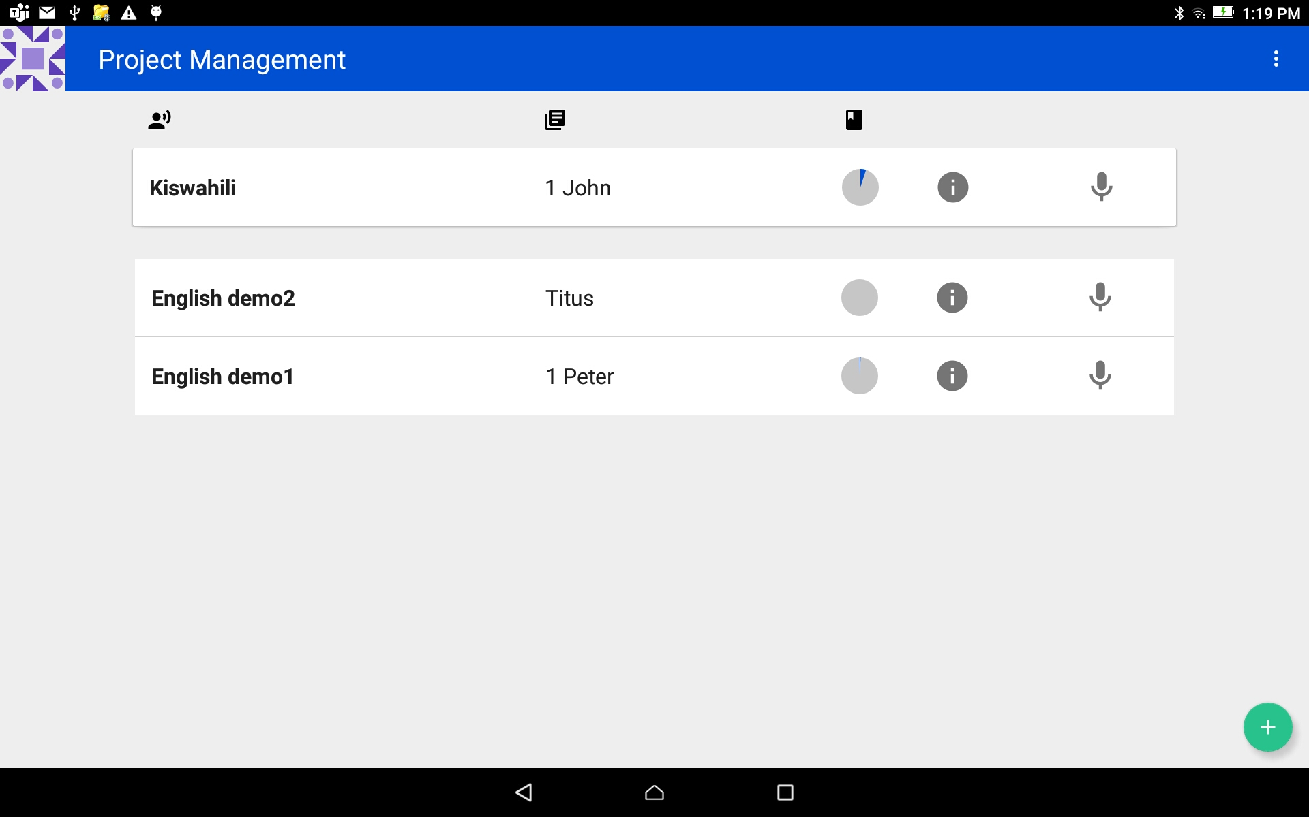
Audio Recordings
Tap on the project bar to open the project.
The project that was worked on last is at the top of the list.

Slide 5
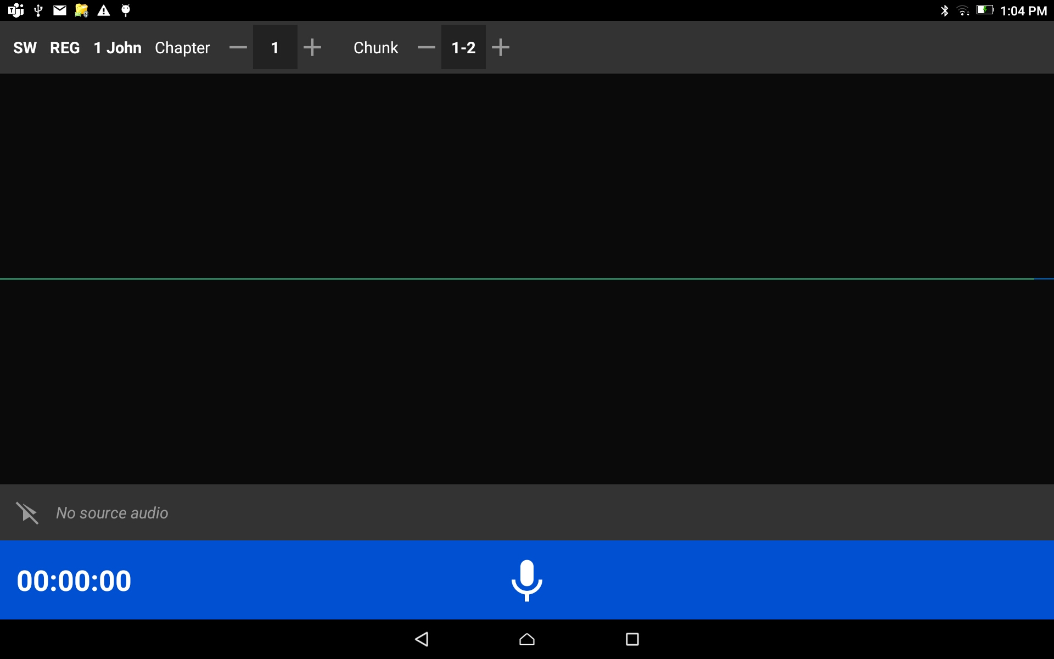
Audio Recordings
The Project Opens:
Have the written text open to the first verse that will be read.

Slide 6
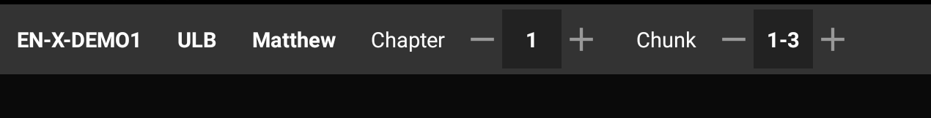
Audio Recordings
Check the information on the top gray bar:
Target Language
Project Type
Book
Chapter
Chapter #
Verse or Chunk
Verse or Chunk Number

Slide 7
Audio Recordings
Check the information on the top gray bar:
Choose the plus and minus signs to change the numbers

Slide 8
Audio Recordings
Tap on the microphone icon on the blue bar.

Slide 9
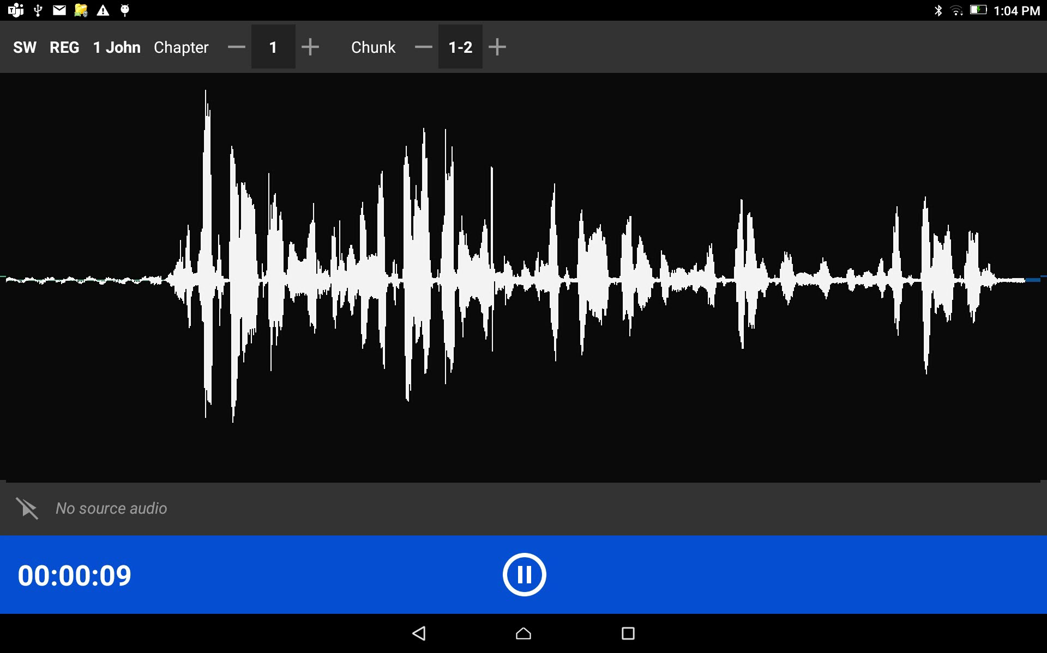
Audio Recordings
As you begin to speak you will see lines appear on the screen which is a result of the sound of your voice.
These lines are known as waves.

Slide 10
Audio Recordings
When done with that portion, tap the pause button.

Slide 11
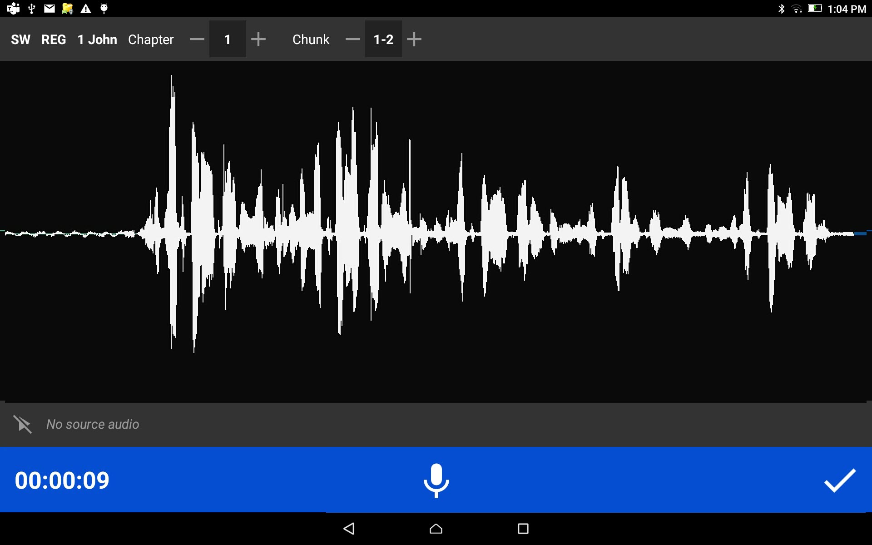
Audio Recordings
Tap the checkmark to save the recording.

Slide 12
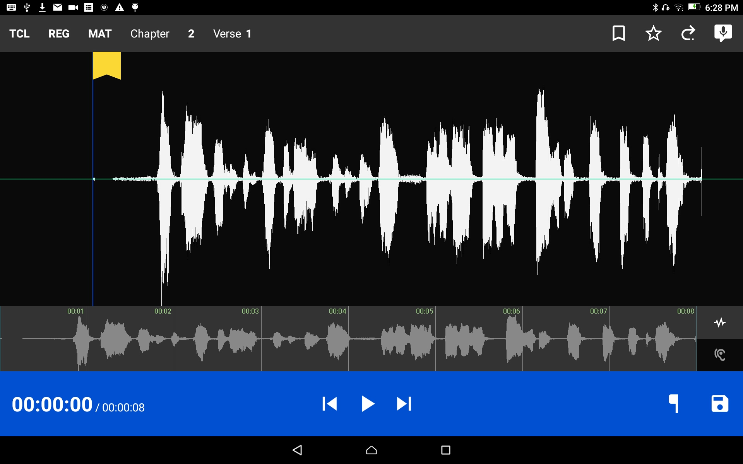
Audio Recordings
Tap the SD disk icon to save the recording and continue recording more verses or chunks of the source text.
The program returns to the Project Management screen.

Slide 13

Audio Recordings
In Project Management screen
Choose the Project by tapping on the Project bar.

Slide 14
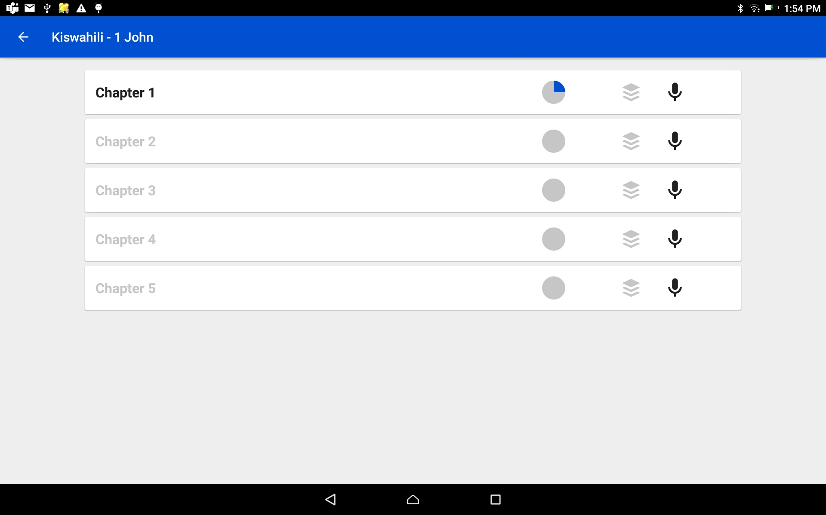
Audio Recordings
A chapter that has a partially filled in circle on the bar is not completed.
In Project Management screen
Choose the chapter by tapping on the Chapter bar.
NOTE: Chapters that have recordings are dark black. Chapters that have no recordings are gray.

Slide 15
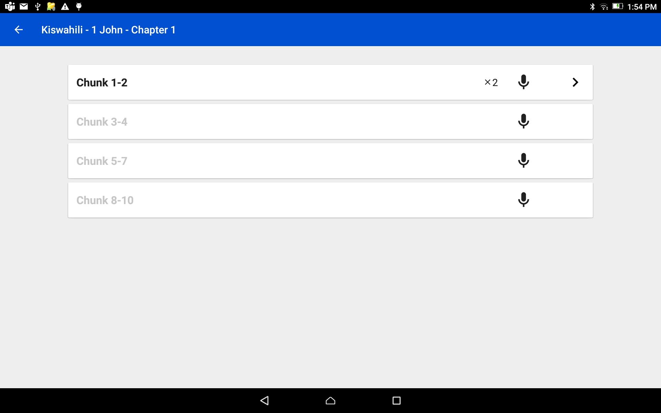
Audio Recordings
In Project Management screen
Choose to record the next Verse or Chunk by tapping on the microphone of the next verse or chunk bar that needs to be recorded.
NOTE: the gray verse needs to be recorded.

Slide 16
Audio Recordings
The Project Opens:
Continue the reading for the next verse or chunk.
Continue these steps – record, save, open next verse - until all of the verses of each chapter is recorded.

